Slide 1


SLU2002 GROUP-1
Experiential Learning Project Presentation

Slide 2

TEAM MEMBERS
Project Manager- Renukalaxmi Dudhe Team Lead -Akshitha Bysani,
Alex Williams,Ojeah John Project Scribe - Eric-Innocent,
Lucas

Slide 3

Mission Statement
“To commence the project planning process by introducing novel concepts and formulating an efficient event plan for experiential learning that improves the effectiveness of executing the project for the sponsoring company”
Vision Statement
“Professional working with teammates with discipline, respect and honesty for the aim of experiential learning by fulfilling needs of sponsor company”

Slide 4
Project Details
Project: Experential Learning
Sponsor Company: Globalshala
Client: Anushika Jain ( CEO Globalshala)
Project Budget: $30,000
Launch Deadline: JULY 2023
Project Goals
Manage a global project (event) to be launched in the next 6 months
Focuses on creating conversation of importance and relevance of experiential learning among different age groups
Display capabilities and potential of experiential learning
Connect the educators and students globally for modifying skills
Engage the audience by presentation, activities, panel, discussion virtually worldwide mainly students.
Learners will able to gain, insight and reflect into themselves as “how they are applying the theory in practical life”.

Slide 5
Project Task/ Assignment:
Week 1:
Team Charter
Discussion with team members outlining the team's purpose, goals, roles, responsibilities, and expectations to help work effectively and achieve our objectives.
Project Charter
Preparation to give overview of project/event such as project's purpose, goals, scope, stakeholders, resources, timeline, budget, risks,milestones and success criteria. It serves as a guide for the project team to plan, execute, and monitor the project effectively to deliver value.

Slide 6
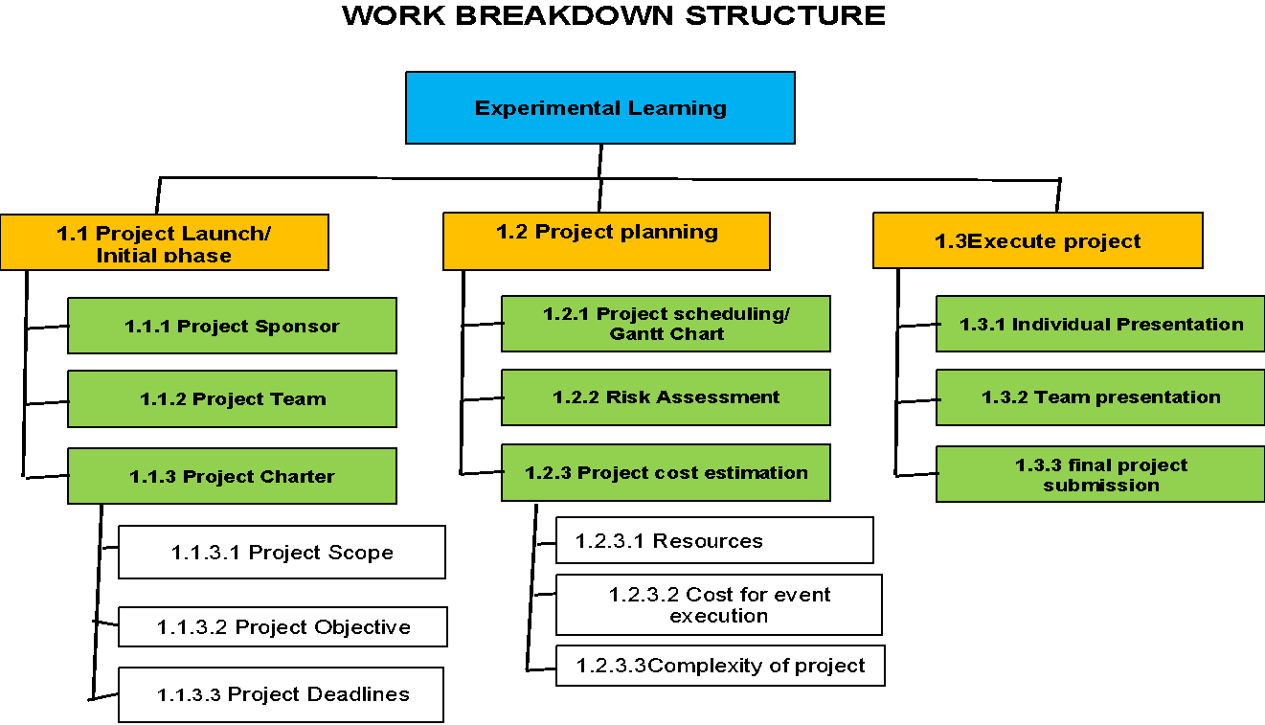
Project Scheduling
WBS:

Slide 7
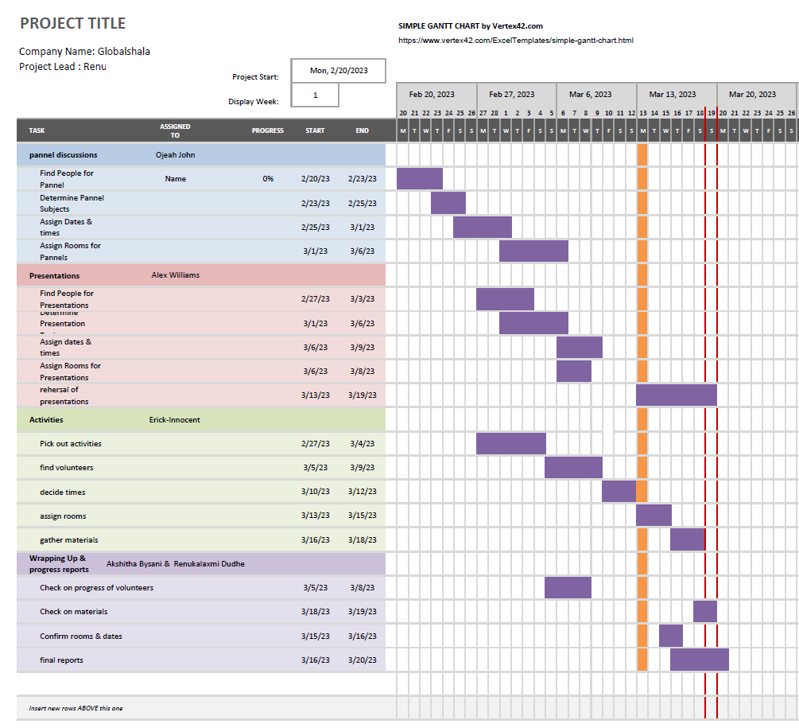
Week 2- Gantt chart:

Slide 8
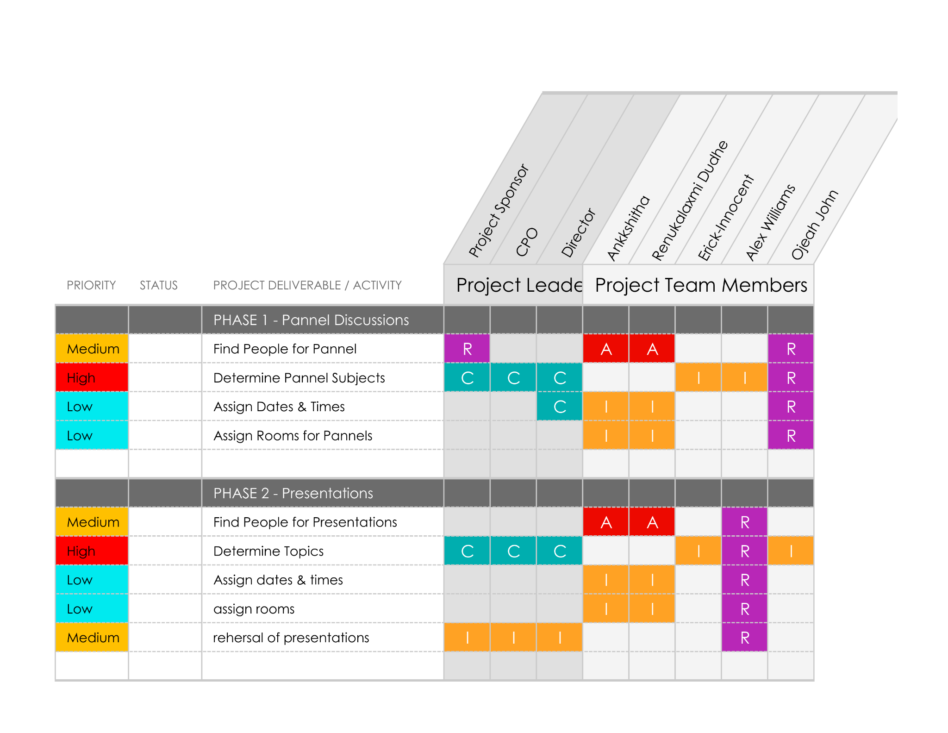
RACI Matrix:

Slide 9
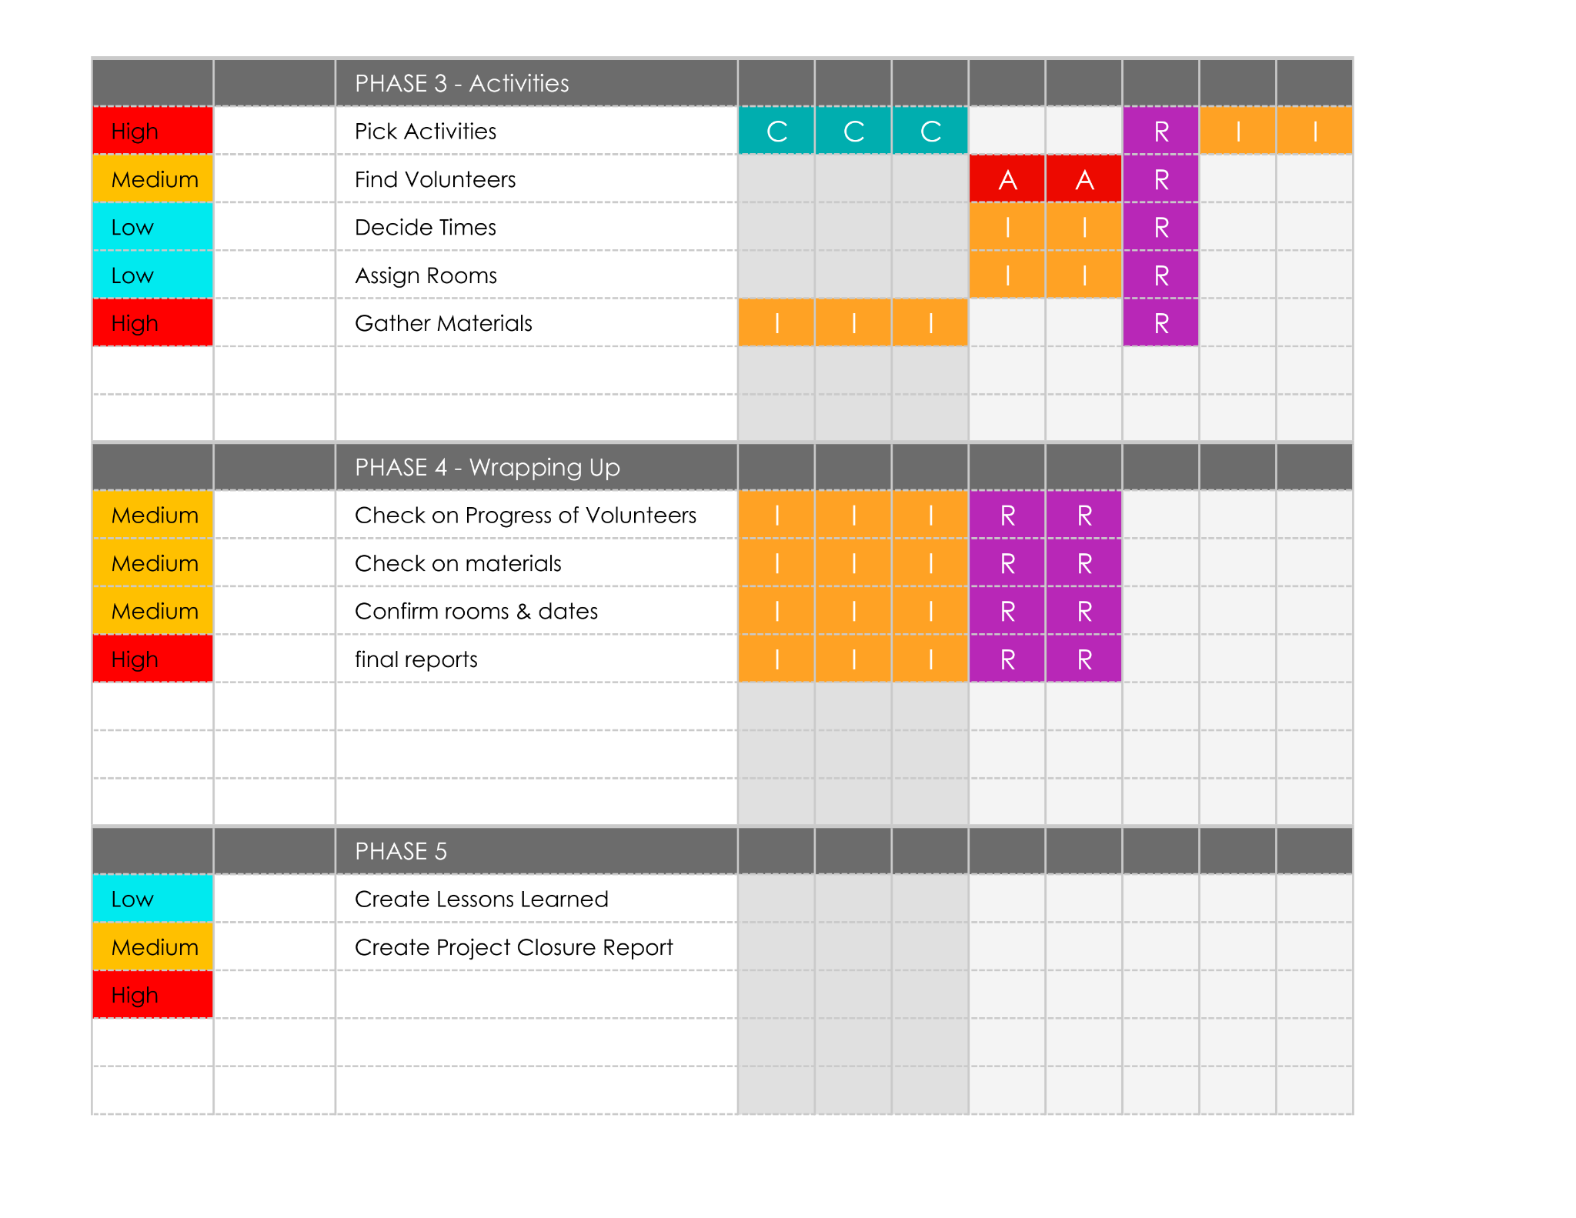
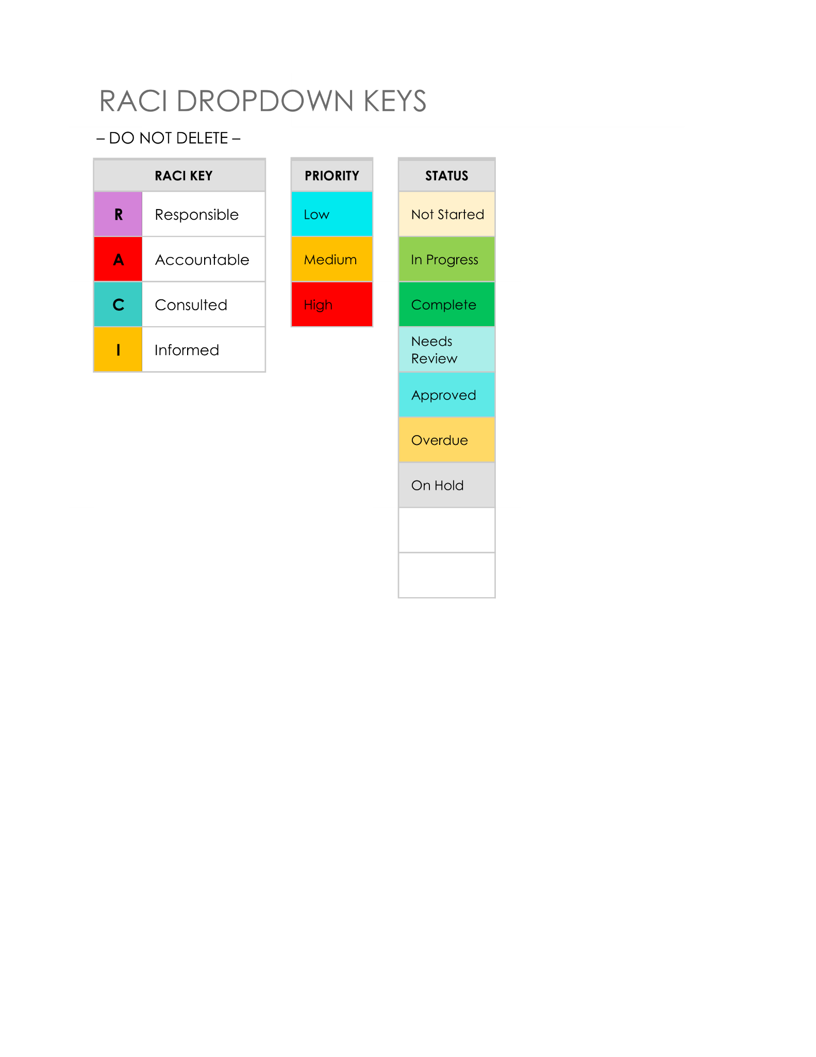

Slide 10
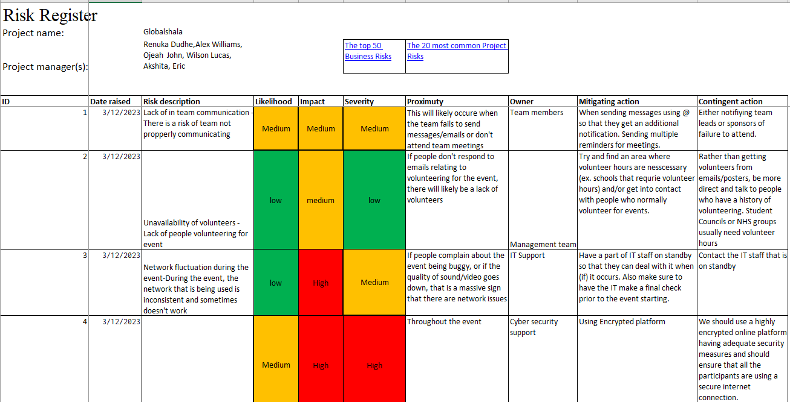
Week 3 Risk Register:
Risk Assessment:

Slide 11
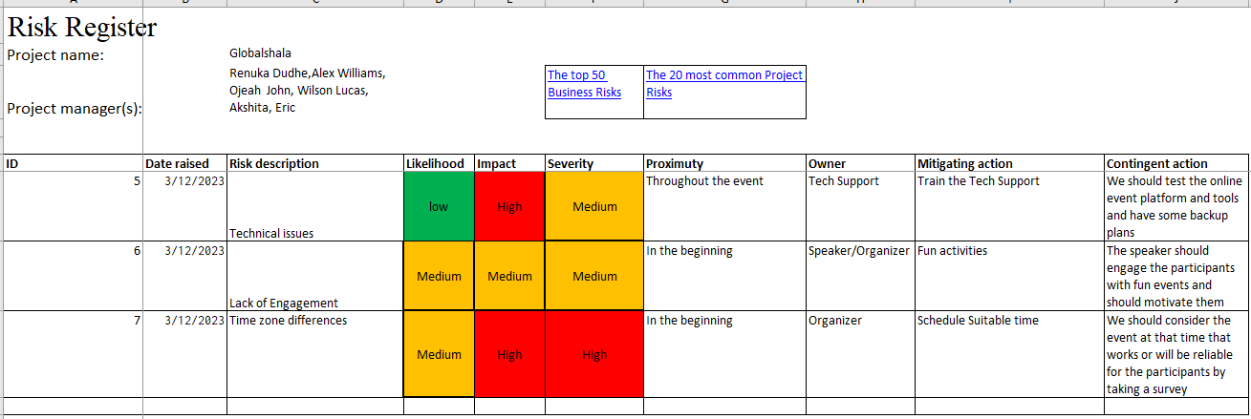
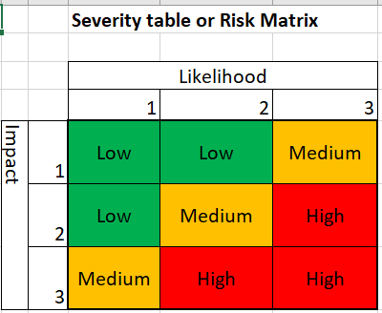

Slide 12
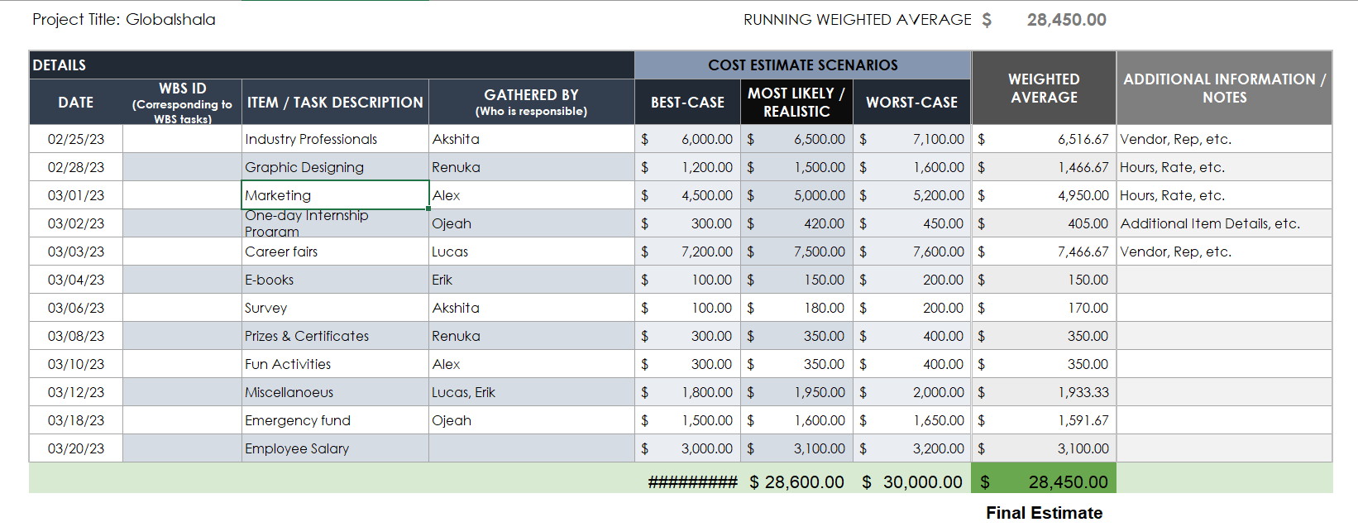
Cost Estimate:

Slide 13

THANK YOU!

